Slide 1
Environmental Pollution
Causes, Effects and Solutions

Slide 2
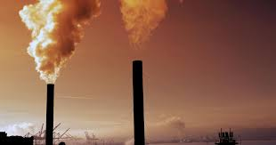
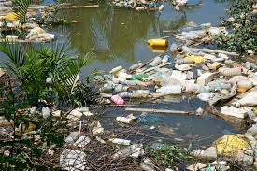
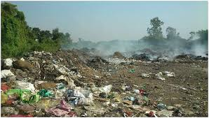
What is environmental pollution?
Definition: The contamination of the natural environment by harmful substance.
Types of pollution:
Air pollution.
Water pollution.
Soil pollution.
Noise pollution.

Slide 3
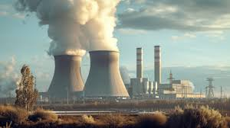
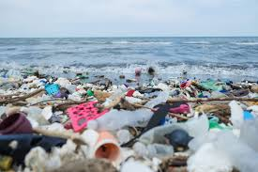
Causes of pollution
Human activities:
Industrial emissions.
Deforestation.
Fossil fuel consumption.
Plastic and waste disposal.
Natural causes:
Volcanic eruptions.
Wildfires.

Slide 4
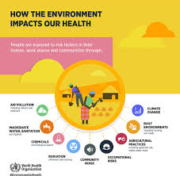
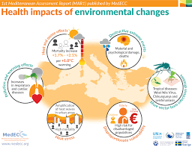
Effects of pollution
On human health:
Respiratory issues, heart diseases, waterborne illnesses.
On environment:
Climate change, global warming, loss of biodiversity.
On economy:
Costs of healthcare, loss of natural resources.

Slide 5
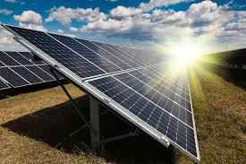


Global solutions to pollution
Preferable solutions:
Use of renewable energy (solar, wind, hydropower).
Recycling and waste management.
Forest conservation and reforestation.

Slide 6
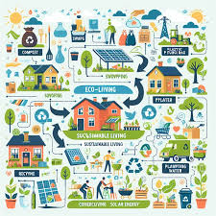

What can individuals do?
Actions at a personal level:
Reduce plastic use (carry reusable bags and bottles).
Conserve energy water.
Spread awareness about pollution sustainability.

Slide 7
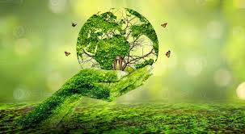
Conclusion
Key message:
Pollution is a serious issue but can be tackled through global efforts and individual actions.
Call to action:
“Together, let’s protect our planet for future generations!”
THE END

